Slide 1
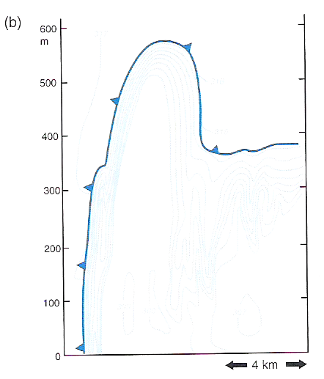
Density Current Schematic
Note the isentrope orientation (faint blue lines): higher-valued ahead of density current (>317 K), lower-valued (307-309 K) behind leading edge.
Flow that conserves potential temperature will ascend over the density current; it will not pass through the density current. In this sense, density currents are material surfaces.
density current head
Markowski and Richardson (2010), their Fig. 5.2b

Slide 2
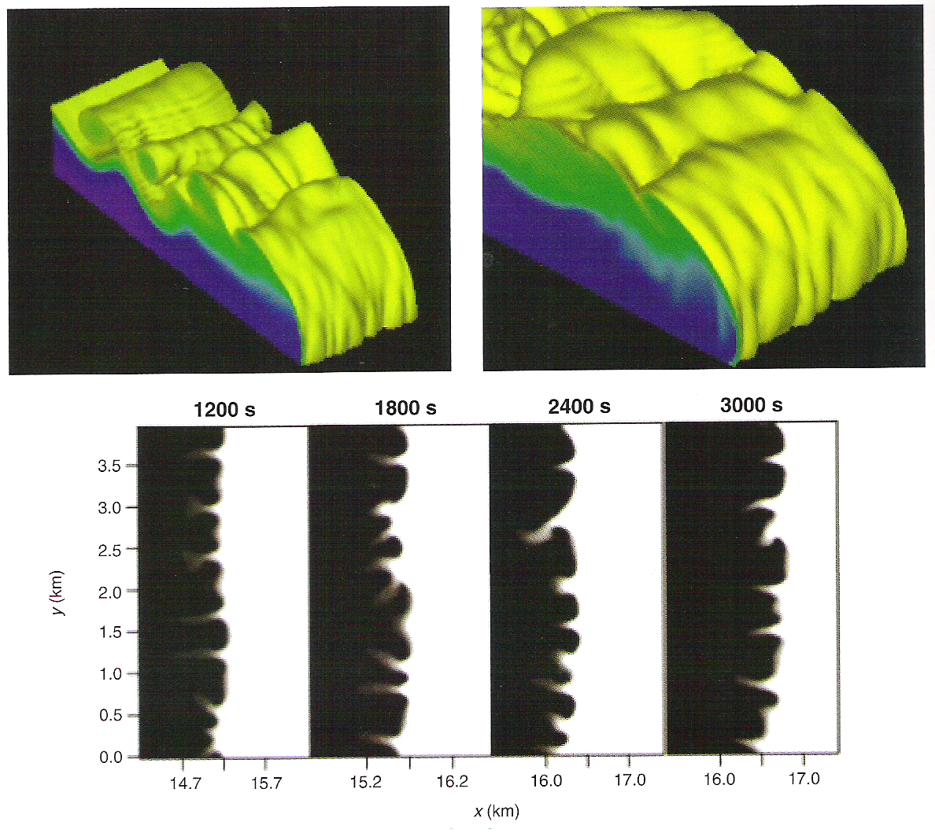
Generic Density Currents
While quasi-2D, note the clefts and lobes along the leading edge and billows along the top.
Markowski and Richardson (2010), their Fig. 5.27

Slide 3
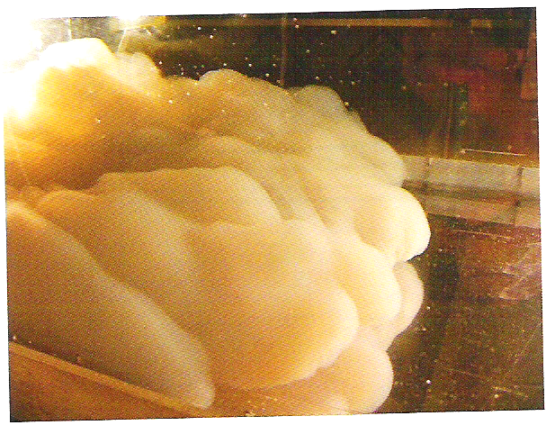
Generic Density Currents
Markowski and Richardson (2010), their Fig. 5.25

Slide 4
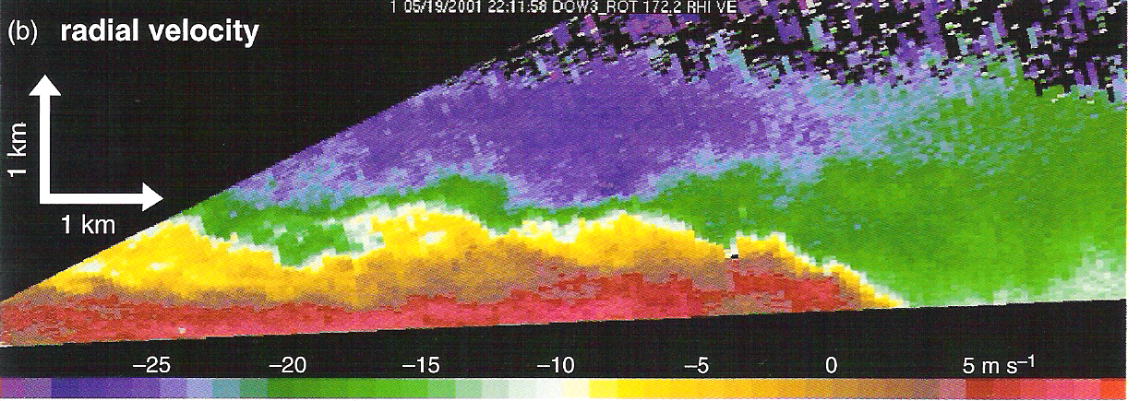
Radar Density Current Depiction
radar
Markowski and Richardson (2010), their Fig. 5.26b

Slide 5
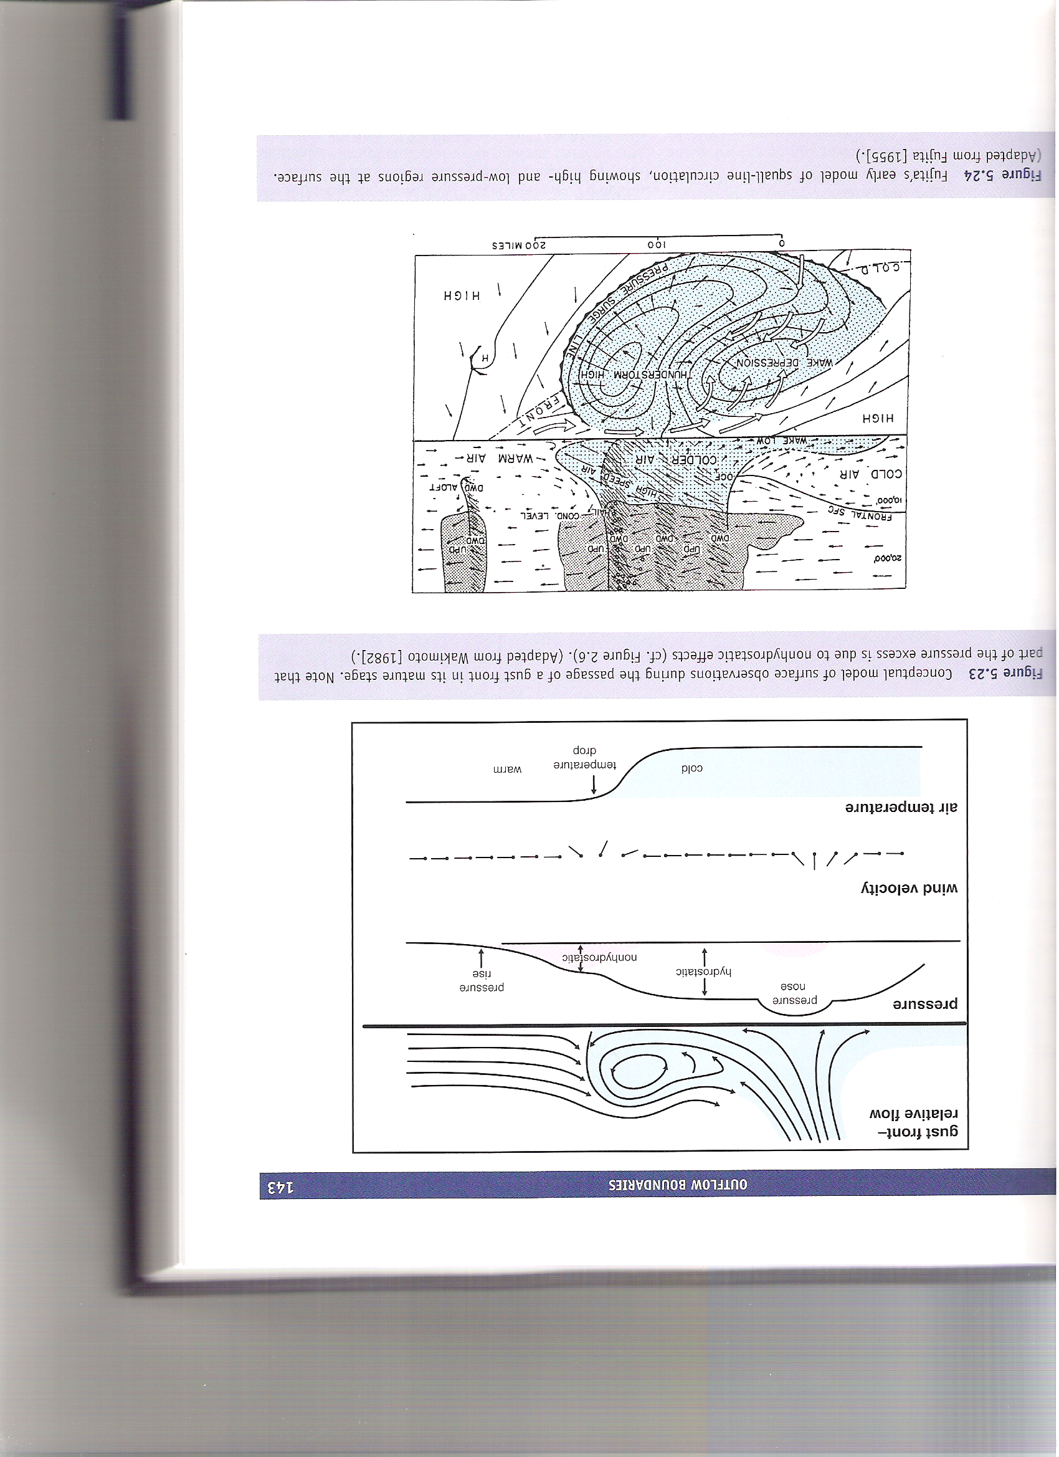
Outflow Boundaries
convergence
divergence
Markowski and Richardson (2010), their Fig. 5.23

Slide 6
Outflow Boundaries
subsaturated descent (compressional warming)
PGF
Markowski and Richardson (2010), their Fig. 5.24

Slide 7
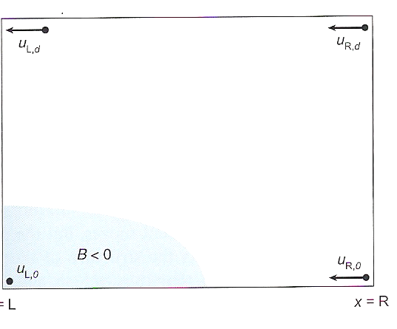
Density Current Dynamics
z = d
Here, we will assume for simplicity that the ambient wind (and vertical wind shear) are zero.
We also assume no ambient buoyancy and no friction.
H
z = 0
x = L
Markowski and Richardson (2010), their Fig. 5.29

Slide 8
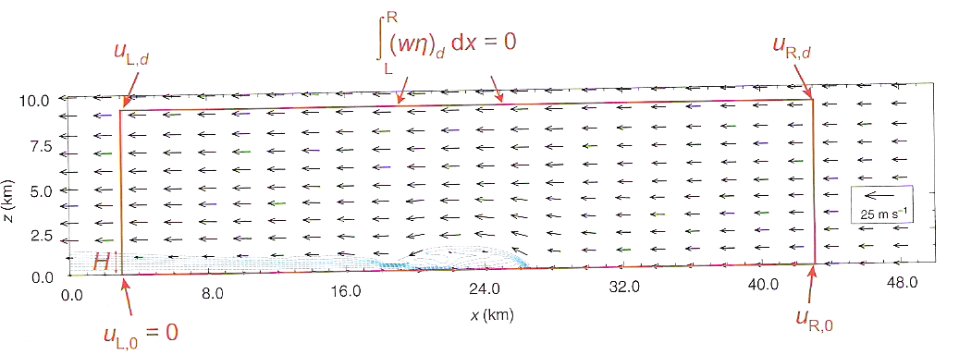
Density Current Dynamics
For this example, H ~ 1 km, θ_{v}’ ~ -10 K, and θ_{v}(env) ~ 300 K, such that u_{R,0} = 18 m s⁻¹. This agrees well with the numerical simulation output depicted above (with zero ambient flow; all vectors are relative to the density current’s motion).
Markowski and Richardson (2010), their Fig. 5.30

Slide 9
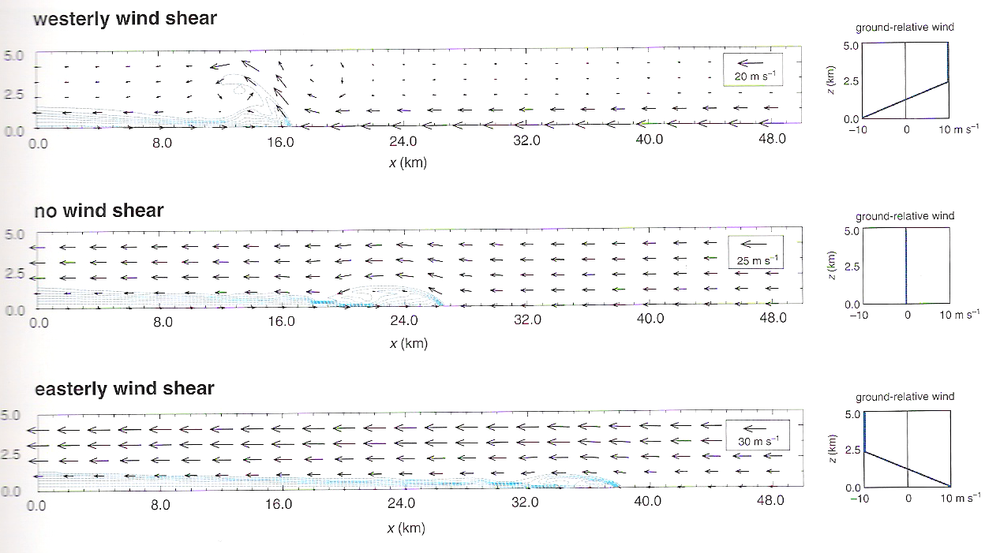
Density Current Lifting In Sheared Flows
Strongest ascent occurs when the surface ground-relative flow equals and opposes density current motion.
Not shown: lifting is maximized when the shear depth is ~75% of the density current depth.
Density currents spread out more rapidly for ambient flow in the same direction as density current motion; however, lifting along their leading edge is reduced.
Markowski and Richardson (2010), their Fig. 5.31

